Slide 1


Pokémon : Gen 1 gotta graph em all
Ian Arch, Paige Breyfogle, Daniel Buescher, Andrew Stepanek
Ya know.. Instead of catch em all… oof tough crowd

Slide 2

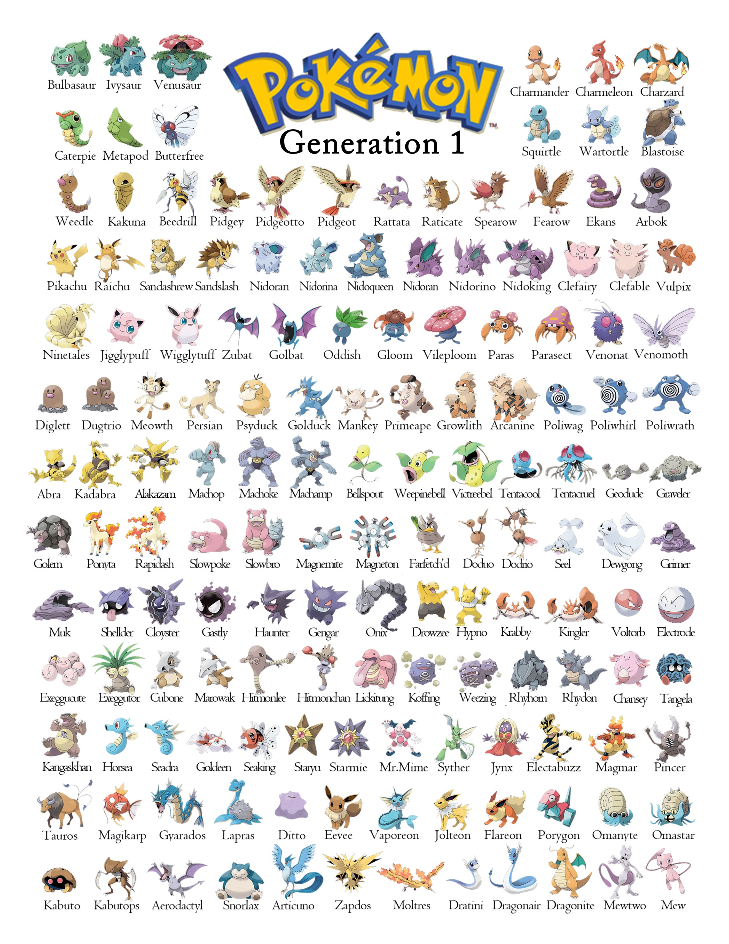

Theme
The topic that we have chosen is Pokemon, the reason we have chose this topic is the nostalgia factor because of Pokémon's prominence in our childhood, as well as educating the current youth on the Original (OG) Gen 1 Pokémon.

Slide 3
Coding approach/ how we did it
Pulled in Gen 1 list from Kaggle data set , used jupyter to read csv in pandas, created data frame from data set, pulled a list of names
Created data frame with their name and empty list of stats,
Called out to existing Poke API https://pokeapi.co/to pull data in , each Pokemon had a extensive list of URL links for stats so used poke-list in a for loop to call out to each URL to retrieve stats from empty data frame
Exported data frame to CSV

Slide 4
Continued
Created SQL database using PGAdmin, imported data frame CSV
Created python-flask powered API, created routes for each type of Pokemon
Created HTML file to lay out page and used CSS to style
Used d3 & plotly within Javascript to read Json files from flask- API to create visualizations of data

Slide 5
Final Visualization
We wanted to have graphic representation of the different stats and incorporate some interaction with updates based on the selected Pokémon type.
We broke the data down into the types, so it was more visually appealing and easier to digest.
We used a JavaScript library not covered in class , Anime.js which allowed us to create the small animation of the title upon the loading of the page

